Slide 1


Vrinda store
CHOOSE YOUR STYLE

Slide 2

Vrinda Store Annual Sales Report 2022
Subtitle: Comprehensive Analysis and Strategic Recommendations
Presented by: Akash Pandhare
Email : akashpandhare0097@gmail.com

Slide 3
About Vrinda Store :
Overview: Vrinda Store is a clothing store selling products through various online channels such as Amazon, Flipkart, Myntra, and Ajio.

Slide 4
Objective:
To create an annual sales report for 2022.
To help Vrinda Store understand their customer base and store performance.
To provide insights for strategic planning and growth in 2023.

Slide 5
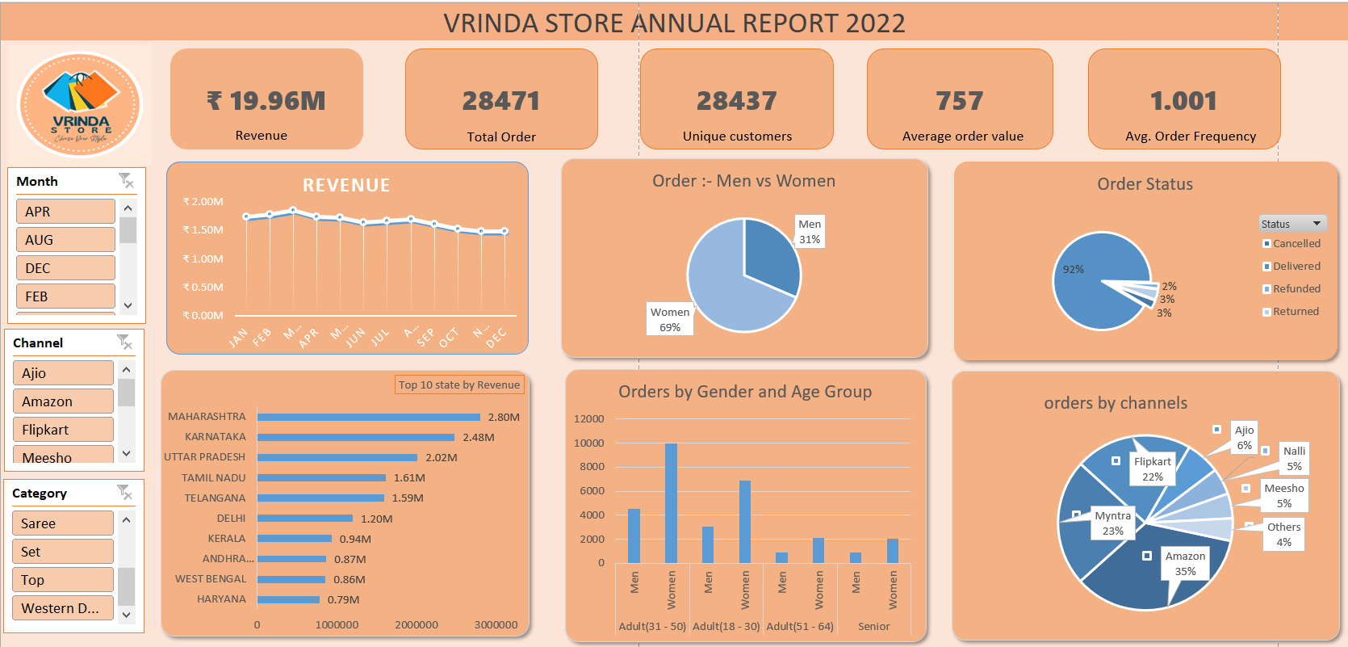

Slide 6
INSIGHTS AND ANALYSIS
Vrinda Store generated a total revenue of ₹19.96 million from 28,471 orders placed by 28,437 unique customers.
The average order value was ₹757, and the average order frequency was just over 1.
Womens are more likely to buy compare to men . (~69%)
The age group of 31-50 years was the largest contributor to sales, followed by the 18-30 years group.
Maharashtra, Karnataka, and Uttar Pradesh were the top-performing states, while Amazon, Flipkart, and Myntra were the leading sales channels.
The order status rates showed that 92% of the orders were delivered successfully."

Slide 7

Conclusion
Vrinda Store should focus on targeting women aged 18-50 years, especially in Maharashtra, Karnataka, and Uttar Pradesh, as these groups have shown the highest engagement. Leveraging top-performing channels like Amazon, Flipkart, and Myntra with targeted ads, offers, and coupons can help increase customer engagement and sales.
Seasonal promotions and discounts should also be highlighted to attract more customers."
"Fashion is the armor to survive everyday life." - Bill Cunningham

Slide 8
Recommendations to Improve Sales and Engagement:
Improve Customer Engagement:
Increase AOF by introducing loyalty programs and regular follow-ups.
Offer personalized discounts and product recommendations.
Introduce new collections based on customer preferences.
Analyze feedback to refine and expand the product line.
Try to improve customer retention and encourage repeat purchases.

Slide 9
Next Steps for Vrinda Store:
Action Plan:
Implement targeted marketing campaigns.
Enhance customer retention strategies.
Monitor performance regularly using updated dashboards.
Goals for 2023:
Increase revenue and order volume.
Strengthen customer loyalty and engagement.
Expand market reach and optimize sales channels.

Slide 10
THANK YOU !

